Slide 1
Computer Networks
UNIT-I: INTRODUCTION AND PHYSICAL LAYER
Introduction:
Network Hardware
Network Software
Reference Models - OSI, TCP/IP
Example Networks – Internet; Wireless LANs - 802.11.
Physical Layer:
Guided Transmission Media
Wireless Transmission.

Slide 2
Introduction
The Historical Perspective
The 18th century: the great mechanical systems accompanying the Industrial Revolution.
The 19th century: steam engine.
The 20th century: information gathering, processing, and distribution.
The 21th century: Internet, large distributed systems (e.g., Grid), heavy reliance on computers.

Slide 3
Introduction (Cont’d)
What is Computer Network?
we will use the term ''computer network'' to mean a collection of autonomous computers interconnected by a single technology.
Two computers are said to be interconnected if they are able to exchange information.
copper wire; fiber optics, microwaves, infrared, and communication satellites, etc.

Slide 4
USE OF COMPUTER NETWORKS
Business applications.
Home Applications.
Mobile Users .
Social Issues.

Slide 5
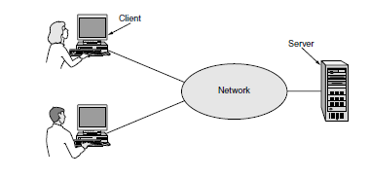
1. Business applications- Resource sharing
A network with two clients and one server.
Computer Network Goals:
Client-server model- Web application.
A second goal of a computer network can provide a powerful communication medium among employees.- email (electronic mail).
Telephone calls between employees may be carried by the computer network instead of by the phone company. This technology is called IP telephony or Voice over IP (VoIP).
A third goal for many companies is doing business electronically, especially with customers and suppliers. This new model is called e-commerce (electronic commerce)
This reduces the need for large inventories and enhances efficiency

Slide 6
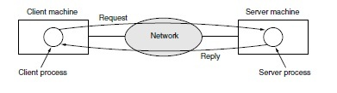
The client-server model involves requests and replies.
2. Home Applications
Internet access provides home users with connectivity to remote
computers.
The more popular uses of the internet for home users are as follows:
Access to remote information.
Person-to-Person Communication.- peer-to-peer communication
Interactive Environment.
Electronic Commerce.

Slide 7
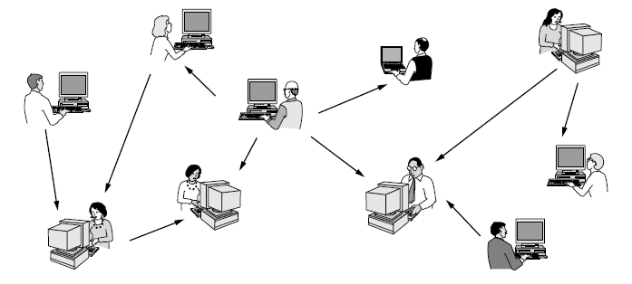
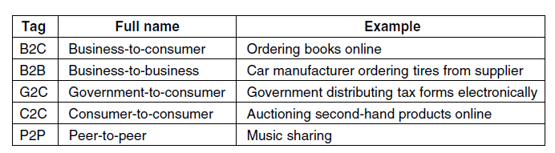
peer-to-peer communication:
In a peer-to-peer system there are no fixed clients and servers
Some forms of e-commerce

Slide 8
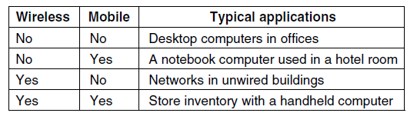
3. Mobile User
Combinations of wireless networks and mobile computing
PDAs’
WAP 1.0 Wireless Application Protocol.
WAP 2.0
Mobile Commerce- M-commerce
4. Social Issues

Slide 9
I. Network Hardware
2 types of transmission technologies
Broadcast
Broadcast networks have a single communication channel that is shared by all the machines on the network.
Short messages, called packets in certain contexts, sent by any machine are received by all the others. (Address Checking required)
Point-to-point
In point-to-point networks, there consist of many connections between individual pairs of machines.
As a general rule (although there are many exceptions), smaller, geographically localized networks tend to use broadcasting, whereas larger networks usually are point-to-point.
Point-to-point transmission with exactly one sender and exactly one receiver is sometimes called unicasting.

Slide 10
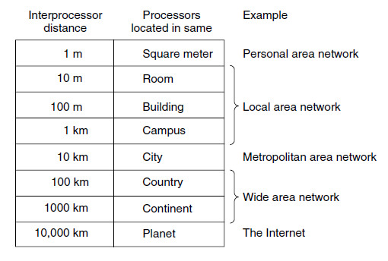
Classification of interconnected processors by scale

Slide 11
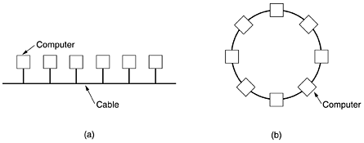
LAN: local area network
Local area networks, generally called LANs, are privately-owned networks within a single building or campus of up to a few kilometers in size.
LANs may use a transmission technology consisting of a cable to which all the machines are attached.
Traditional LANs run at speeds of 10 Mbps to 1000 Mbps, have low delay (microseconds or nanoseconds), and make very few errors.
Various topologies are
possible for broadcast
LANs.
(a) Bus (b) Ring

Slide 12
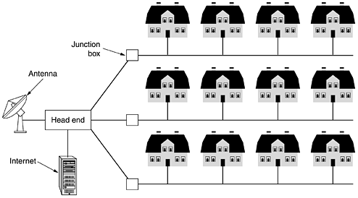
MAN: metropolitan area network

Slide 13
WAN and Internet
Hosts, The hosts are owned by the customers (e.g., people's personal computers).
Subnet, typically owned and operated by a telephone company or Internet service provider (ISP).
The hosts are connected by subnets.
the subnet consists of two distinct components: transmission lines and switching elements. Transmission lines move bits between machines. Switching elements (routers) are specialized computers that connect three or more transmission lines.

Slide 14
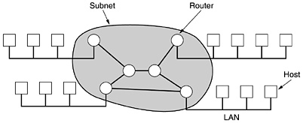
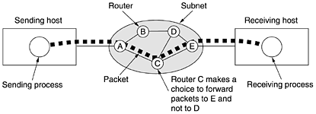
WAN and Internet
Simple WAN (Internet) illustrated
Packets routing

Slide 15
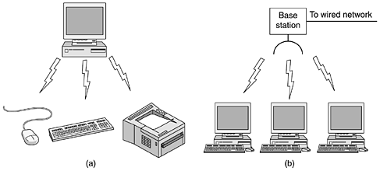
Wireless Networks
Bluetooth: short range wireless network (<10m).
Wireless LANs: for moderate range, becomes more and more common today (<100m).
network used for cellular telephones: distances involved are much greater and the bit rates much lower (above 1km).

Slide 16
II. Network Software
Network Software
Protocol Hierarchies
Design Issues for the Layers
Connection-Oriented and Connectionless Services
Service Primitives
The Relationship of Services to Protocols

Slide 17
Network Software (Cont’d)
1. Protocol Hierarchies
To reduce their design complexity, most networks are organized as a stack of layers or levels, each one built upon the one below it.
The purpose of each layer is to offer certain services to the higher layers, shielding those layers from the details of how the offered services are actually implemented.
A protocol is an agreement between the communicating parties on how communication is to proceed.

Slide 18
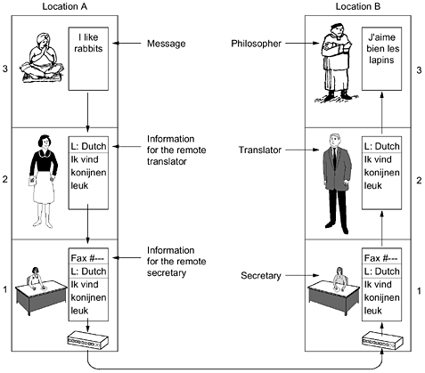
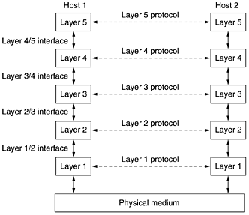
Network Software(Cont’d)
The philosophers analogy
The layered computer network

Slide 19
Network Software (Cont’d)
The key terms
Layers; Protocol;
Interface: Between each pair of adjacent layers is an interface.
Network architecture: A set of layers and protocols is called a network architecture.
Protocol stack: A list of protocols used by a certain system, one protocol per layer, is called a protocol stack.

Slide 20
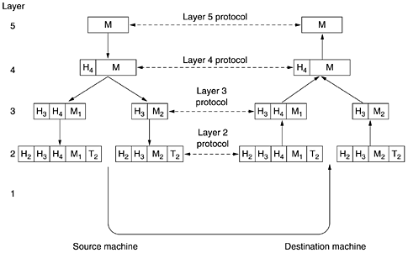
Network Software (Cont’d)
An example network protocol stack
M- Message, H- Header

Slide 21
Network Software (Cont’d)
Message is generated by the application of the source machine.
Message will be sent from the source to the destination.
Message “M” is transferred from layer 5 to layer 4, with a header containing control information, such as sequence numbers, which helps layer 4 maintain the message order.
Layer 3 break the message from layer 4 into two pieces to fit the transmission restrictions, while adding another header to tell layer 2 where the dest. is.
Layer 2 adds the messages from layer 3 with another header, telling the actual (physical) address of the dest, and a trailer, which is the checksum of the message for correction assertion.
At the receiving machine the message moves upward, from layer to layer, with headers being stripped off as it progresses. Message is sent to the dest. machine.

Slide 22
Network Software (Cont’d)
2. Design Issues for the Layers
1. How is it possible that we find and fix these errors?
One mechanism for finding errors in received information uses codes for error detection & correction. Error control is an important issue because physical communication circuits are not perfect.
Another reliability issue is finding a working path through a network. Often there are multiple paths between a source and destination, and in a large network, there may be some links or routers that are broken.- Routing

Slide 23
2. A second design issue concerns the evolution of the network.
protocol layering- Every layer needs a mechanism for identifying senders and receivers. This mechanism is called addressing or naming, in the low and high layers, respectively.
An aspect of growth is that different network technologies often have different limitations.- mechanisms for disassembling, transmitting, and then reassembling messages. This overall topic is called internetworking.
When networks get large, new problems arise. Cities can have traffic jams, a shortage of telephone numbers, and it is easy to get lost.- scalable.
A third design issue is resource allocation.
Design- statistical multiplexing, meaning sharing based on the statistics of demand.
An allocation problem that occurs at every level is how to keep a fast sender from swamping a slow receiver with data.- flow control.

Slide 24
Too many computers want to send too much traffic, and the network cannot deliver it all. This overloading of the network is called congestion.
The last major design issue is to secure the network by defending it against different kinds of threats.
-provide confidentiality defend against this threat, and they are used in multiple layers. Mechanisms for authentication prevent someone from impersonating someone else.
- mechanisms for integrity prevent surreptitious changes to messages, such as altering ‘‘debit my account $10’’ to ‘‘debit my account $1000.’’ All of these designs are based on cryptography

Slide 25
Network Software (Cont’d)
3. Connection-Oriented and Connectionless Services?
Connection-Oriented Service: the service user first establishes a connection, uses the connection, and then releases the connection. (e.g., the telephone, tube)
Connectionless Service: Each message carries the full destination address, and each one is routed through the system independent of all the others. (e.g., the postal system) Usually, connectionless service can not guarantee the order of messages.
In order to enhance the reliability of transmission of connection-oriented service, acknowledge each received message is helpful. For example, the file transfer.
However, some applications prefer fast speed than the reliability. For example, the digitized voice traffic, video conference.

Slide 26
Reliable connection-oriented service has two minor variations:
1. Message Sequences - When two 1024-byte messages are sent,
they arrive as two distinct 1024- byte messages, never as one
2048-byte message.
2. Byte Streams- the connection is simply a stream of bytes,
with no message boundaries.
To download a DVD movie, a byte stream from the server to
the user’s computer is all that is needed.
For some applications, the transit delays introduced by
acknowledgements are unacceptable.
One such application is digitized voice traffic for voice over IP.
Unreliable (meaning not acknowledged) connectionless service is often called datagram service, in analogy with telegram service, which also does not return an acknowledgement to the sender.

Slide 27
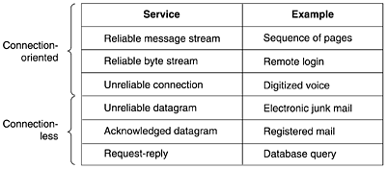
Six different types of service
both reliable and unreliable connection-oriented and connectionless communication coexist

Slide 28
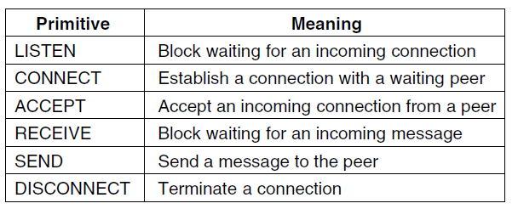
4. Service Primitives
A service is formally specified by a set of primitives (operations) available to user processes to access the service.
These primitives tell the service to perform some action or report on an action taken by a peer entity.
The set of primitives available depends on the nature of the service being provided.
Six service primitives that provide a simple connection-oriented service.

Slide 29
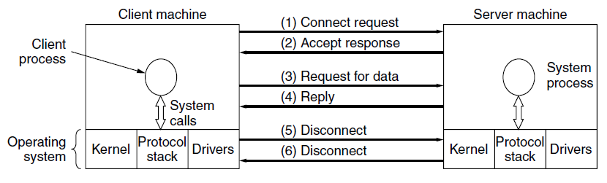
simple client-server interaction using acknowledged datagrams
Packets sent in a simple client-server interaction on a connection-oriented network

Slide 30
III. Reference Models
Two important network architectures:
The OSI reference model (Open Systems Interconnection)
The TCP/IP reference model.
OSI reference model: (Day and Zimmermann, 1983)
Developed by the International Standards Organization (ISO) so it is called as ISO OSI reference model because it deals with connecting open systems for communication with other systems.
It is rarely used today.
OSI model itself is not a network architecture because it does not specify the exact services and protocols to be used in each layer.
Although the protocols associated with the OSI model are not used any more, the model itself is actually quite general and still valid, and the features discussed at each layer are still very important.
TCP/IP reference model: developed by ARPANET (Advanced Research Projects Agency Network)- Used to construct the Internet today.
The model itself is not of much use but the protocols are widely used.

Slide 31
The OSI model has seven layers.
The principles that were applied to arrive at the seven layers can be briefly summarized as follows:
1. A layer should be created where a different abstraction is needed.
2. Each layer should perform a well-defined function.
3. The function of each layer should be chosen with an eye toward defining internationally standardized protocols.
4. The layer boundaries should be chosen to minimize the information flow across the interfaces.
5. The number of layers should be large enough that distinct functions need not be thrown together in the same layer out of necessity and small enough that the architecture does not become unwieldy.

Slide 32
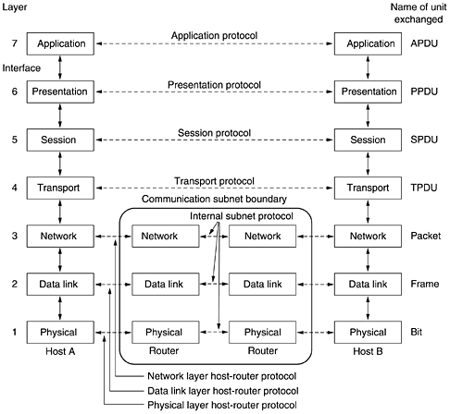
OSI Reference model

Slide 33
The Physical Layer
The physical layer is concerned with transmitting raw bits over a communication channel.
Voltage representation: 0 volts for 0 bit and 5 volts for 1 bit.
Physical media: Wired & Wireless- Twisted pair cables, coaxial cables, fibre optics & Radio , infrared, blue tooth.
Topology: Physical Structure of N/W.
Transmission mode: Simplex, half duplex, full duplex.
Transmission technology: Broadcast & point-to-point.
Bit rate (no. of bits /sec) & Baud rate (no. of bits successfully transmitted /sec) .
Design issues largely deal with mechanical, electrical, and timing interfaces, as well as the physical transmission medium, which lies below the physical layer.

Slide 34
2. The Data Link Layer
The main task of the data link layer is Framing (data frames- typically a few hundred or a few thousand bytes) and transmit the frames sequentially.
If the service is reliable, the receiver confirms correct receipt of each frame by sending back an acknowledgement frame.
Physical Address- Name, Roll no.
Flow (bits checking) & Error (detection & correction) Control.
Acks (acknowledgement) : +ve- data success- ACK
& -ve- data loss- NAK.
Data retransmission (fail or retransmit) and Error frames (damage or loss).
Sequence no.: Access controlling & Accounting & billing.
having the sender break up the input data into data frames and transmit the frames sequentially.
How to control access to the shared channel. A special sublayer of the data link layer, the medium access control sublayer, deals with this problem.

Slide 35
3. The Network Layer:
The network layer controls the operation of the subnet(routing).
A key design issue is determining how packets are routed from source to destination.
Network Layer issue: Handling congestion.
The quality of service provided (delay, transit time, jitter, etc.)
4. The Transport Layer:
The basic function of the transport layer is to accept data from above, split it up into smaller units if need be, pass these to the network layer, and ensure that the pieces all arrive correctly at the other end.
The transport layer Services: The most popular type of transport connection is an error-free point-to-point channel that delivers messages or bytes in the order in which they were sent.
The transport layer is a true end-to-end layer, all the way from the source to the destination.
The difference between layers 1 through 3, which are chained, and layers 4 through 7, which are end-to-end.

Slide 36
5. The Session Layer
The session layer allows users on different machines to establish sessions between them.
Sessions offer various services, including Dialog Control (keeping track of whose turn it is to transmit), Token Management (preventing two parties from attempting the same critical operation simultaneously), and Synchronization (check pointing long transmissions to allow them to pick up from where they left off in the event of a crash and subsequent recovery).
6. The Presentation Layer
concerned with the syntax and semantics of the information transmitted, to make it possible for computers with different data representations to communicate.
7. The Application Layer
The application layer contains a variety of protocols that are commonly needed by users.
One widely used application protocol is HTTP (Hyper Text Transfer Protocol), which is the basis for the World Wide Web.
File Transfer, Electronic Mail, and Network News etc…

Slide 37
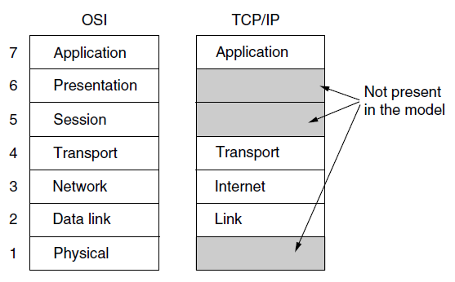
The TCP/IP Reference Model
The ARPANET was a research network sponsored by the DoD (U.S. Department of Defense).
It was first described by Cerf and Kahn (1974), and later refined and defined as a standard in the Internet community (Braden, 1989).
The design philosophy behind the model is discussed by Clark (1988).
The TCP/IP reference model
The Link Layer: describes what links such as serial lines and classic Ethernet must do to meet the needs of this connectionless internet layer. - an interface between hosts and transmission links.

Slide 38
The Internet Layer :
Its job is to permit hosts to inject packets into any network and have them travel independently to the destination (potentially on a different network). They may even arrive in a different order than they were sent, in which case it is the job of higher layers to rearrange them, if in-order delivery is desired.
The internet layer defines an official packet format and protocol called IP (Internet Protocol). The job of the internet layer is to deliver IP packets where they are supposed to go.
The underlining Host-to-Network Layer is a great void. host connected to this layer can send IP packets.

Slide 39
Introduction (Cont’d)
The Transport Layer
It is designed to allow peer entities on the source and destination hosts to carry on a conversation
Two end-to-end transport protocols have been defined here. The first one, TCP (Transmission Control Protocol), is a reliable connection-oriented protocol that allows a byte stream originating on one machine to be delivered without error on any other machine in the internet.
The second protocol in this layer, UDP (User Datagram Protocol), is an unreliable, connectionless protocol for applications that do not want TCP's sequencing or flow control and wish to provide their own.

Slide 40
The Application Layer
The TCP/IP model does not have session or presentation layers, which are of little use to most applications.
It contains all the higher-level protocols. The early ones included virtual terminal (TELNET), file transfer (FTP), and electronic mail (SMTP). Many other protocols have been added to these over the years: the Domain Name System (DNS) for mapping host names onto their network addresses, Network News Transfer Protocol (NNTP) is an application protocol used for transporting Usenet news articles (netnews) between news servers and for reading and posting articles by end user client applications, the protocol for moving USENET news articles around, and HTTP, the protocol for fetching pages on the World Wide Web, and many others.

Slide 41
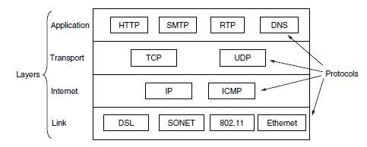
The TCP/IP model with some protocols we will study.

Slide 42
Comparison of the OSI and TCP/IP Reference Models
Similarities
Both are based on the concept of a stack of independent
protocols.
Both of them have transport layer to provide an end-to-end,
network-independent transport service
Differences
In OSI, a layer's service definition tells what the layer
does, and a layer's interface tells the processes above it
how to access it, without explaining how the layers works inside.
The TCP/IP model did not clearly distinguish between service, interface of the layers.
As a consequence, the protocols in the OSI model are better hidden than in the TCP/IP model and can be replaced relatively easily as the technology changes.
OSI model strives to describe the general model of network protocols, while TCP/IP model is specific as it is defined after the real implementations. So TCP/IP model is not useful to describe other protocols.

Slide 43
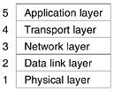
The hybrid reference model

Slide 44
Three concepts are central to the OSI model:
1. Services
2. Interfaces
3. Protocols
The service definition tells what the layer does, not how entities above it access it or how the layer works. It defines the layer’s semantics.
A layer’s interface tells the processes above it how to access it. It specifies what the parameters are and what results to expect. It, too, says nothing about how the layer works inside.
Finally, the peer protocols used in a layer are the layer’s own business. It can use any protocols it wants to, as long as it gets the job done (i.e., provides the offered services). It can also change them at will without affecting software in higher layers.

Slide 45
A Critique of the OSI Model and Protocols
Neither the OSI model and its protocols nor the TCP/IP model and its protocols are perfect.
Quite a bit of criticism can be, and has been, directed at both of them.
1. Bad timing.
2. Bad technology.
3. Bad implementations.
4. Bad politics.

Slide 46
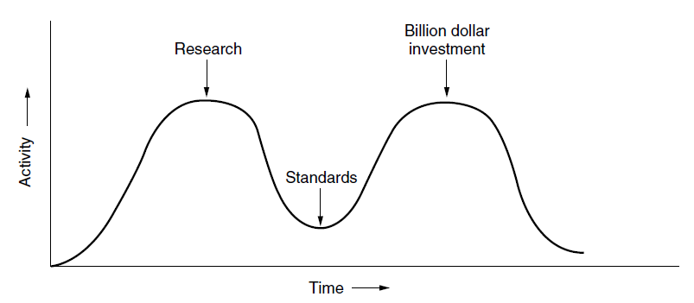
The apocalypse of the two elephants
1. Bad timing The time at which a standard is established is absolutely critical to its success.
David Clark of M.I.T. has a theory of standards that he calls the apocalypse of the two elephants.

Slide 47
2. Bad Technology: The OSI model, along with its associated service definitions and protocols, is extraordinarily complex.
They are also difficult to implement and inefficient in operation.
Q: What do you get when you cross a mobster with an international standard?
A: Someone who makes you an offer you can’t understand.
In addition to being incomprehensible, another problem with OSI is that some functions, such as addressing, flow control, and error control, reappear again and again in each layer.
3. Bad Implementations: It did not take long for people to associate ‘‘OSI’’ with ‘‘poor quality.’’ Although the products improved in the course of time, the image stuck.
In contrast, one of the first implementations of TCP/IP was part of Berkeley UNIX and was quite good (not to mention, free).

Slide 48
4. Bad Politics:
On account of the initial implementation, many people, especially in academia, thought of TCP/IP as part of UNIX,
and UNIX in the 1980s in academia was not unlike parenthood (then incorrectly called motherhood) and apple pie.
OSI, on the other hand, was widely thought to be the creature of the European telecommunication ministries, the European Community, and later the U.S. Government.

Slide 49
A Critique of the TCP/IP Reference Model
The TCP/IP model and protocols have their problems too. First, the model does not clearly distinguish the concepts of services, interfaces, and protocols.
Good software engineering practice requires differentiating between the specification and the implementation, something that OSI does very carefully, but TCP/IP does not.
Consequently, the TCP/IP model is not much of a guide for designing new networks using new technologies.
Second, the TCP/IP model is not at all general and is poorly suited to describing any protocol stack other than TCP/IP. Trying to use the TCP/IP model to describe Bluetooth, for example, is completely impossible.

Slide 50
Third, the link layer is not really a layer at all in the normal sense of the term as used in the context of layered protocols. It is an interface (between the network and data link layers).
The distinction between an interface and a layer is crucial, and one should not be sloppy about it.
Fourth, the TCP/IP model does not distinguish between the physical and data link layers. These are completely different. The physical layer has to do with the transmission characteristics of copper wire, fiber optics, and wireless communication.
The data link layer’s job is to delimit the start and end of frames and get them from one side to the other with the desired degree of reliability.
A proper model should include both as separate layers.
The TCP/IP model does not do this.
Finally, although the IP and TCP protocols were carefully thought out and well implemented, many of the other protocols were ad hoc, generally produced by a couple of graduate students hacking away until they got tired.

Slide 51
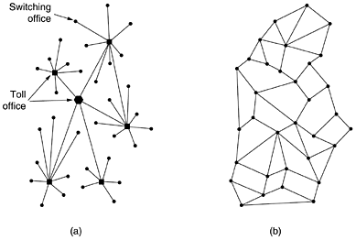
IV. Example Networks — The Internet
Structure of the telephone system.
(b) Baran's proposed distributed switching system.

Slide 52
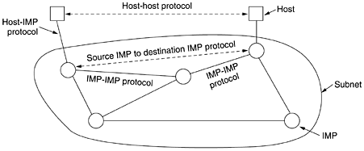
Example Networks — The Internet 2
The original ARPANET design ( IMP - Interface Message Processors- minicomputers)

Slide 53
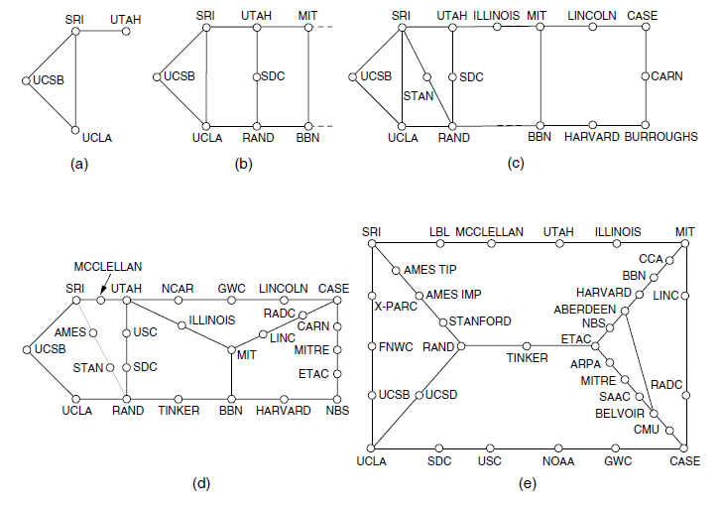
Growth of the ARPANET. (a) December 1969. (b) July 1970.
(c) March 1971. (d) April 1972. (e) September 1972.

Slide 54
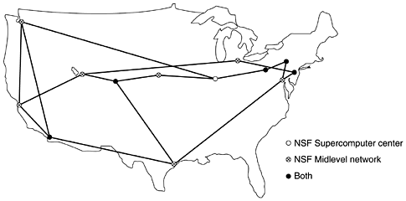
Example Networks — The Internet 3
The NSFNET (National Science Foundation Network) backbone in 1988
Microcomputer called a fuzzball.
The fuzzballs were connected with 56-kbps leased lines and formed the subnet, the same hardware technology the ARPANET used.
The software technology was different however: the fuzzballs spoke TCP/IP right from the start, making it the first TCP/IP WAN.

Slide 55
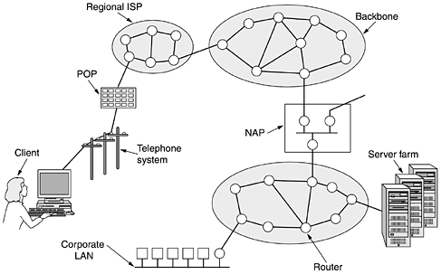
Example Networks —— The Internet 4
Architecture of the Internet
POP: Point Of Presence
ISP: Internet Service Provider
NAP: Network Access Point

Slide 56
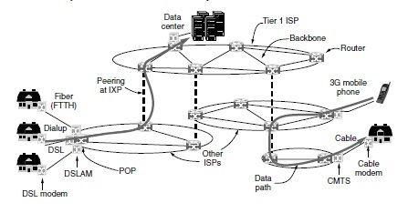
Overview of the Internet architecture internet exchange points- ixps fiber to home -ftth DSLAM (Digital Subscriber Line Access Multiplexer) CMTS: Cable Modem Termination System

Slide 57
A common way to connect to an ISP is to use the phone line to your house, in which case your phone company is your ISP.
DSL- Digital Subscriber Line, reuses the telephone line that connects to your house for digital data transmission.
The computer is connected to a device called a DSL modem that converts between digital packets and analog signals that can pass unrestricted over the telephone line.
At the other end, a device called a DSLAM (Digital Subscriber Line Access Multiplexer) converts between signals and packets.
Several other popular ways to connect to an ISP are – Dial-up- modem for ‘‘modulator demodulator’’ and refers to any device that converts between digital bits and analog signals.

Slide 58
Another method is to send signals over the cable TV system. Like DSL, this is a way to reuse existing infrastructure.
Cable Modem and the device at the cable head end is called the CMTS (Cable Modem Termination System).
Internet access at much greater than dial-up speeds is called broadband.
ISP networks may be regional, national, or international in scope.
ISPs connect their networks to exchange traffic at IXPs (Internet eXchange Points).
Internet used to be that a machine was on the Internet if it:
(1) ran the TCP/IP protocol stack;
(2) had an IP address; and
(3) could send IP packets to all the other machines on the
Internet.

Slide 59
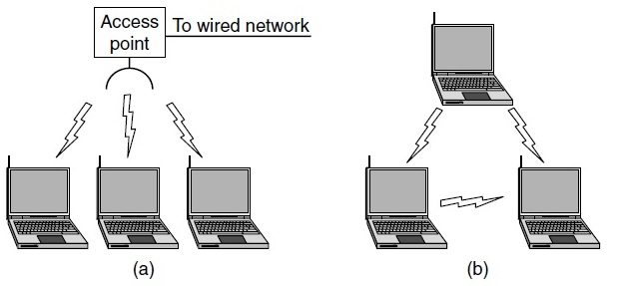
Wireless LANs: 802.11
Wi-Fi - Wireless Fidelity
802.11 networks are made up of clients, such as laptops and mobile phones, and infrastructure called APs (access points) that is installed in buildings. Access points are sometimes called base stations.
The access points connect to the wired network, and all communication between clients goes through an access point.
Two Computers in an office without an access point. This arrangement is called an ad hoc network.
(a) Wireless network with an access point. (b) Ad hoc network

Slide 60
Multipath Fading :
Frequencies used for 802.11, radio signals can be reflected off solid objects so that multiple echoes of a transmission may reach a receiver along different paths.
The echoes can cancel or reinforce each other, causing the received signal to fluctuate greatly-multipath fading.
The key idea for overcoming variable wireless conditions or multipath fading is path diversity, or the sending of information along multiple, independent paths.
The information is likely to be received even if one of the paths happens to be poor due to a fade. These independent paths are typically built into the digital modulation scheme at the physical layer. Options include using different frequencies across the allowed band, following different spatial paths between different pairs of antennas, or repeating bits over different periods of time.

Slide 61
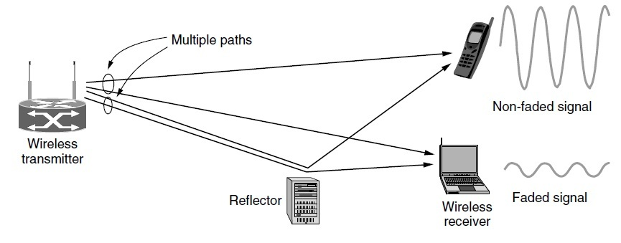
Multipath fading
The 802.11a (1999) and 802.11g (2003) standards switched to a different modulation scheme called OFDM (Orthogonal Frequency Division Multiplexing). It divides a wide band of spectrum into many narrow slices over which different bits are sent in parallel.
The latest version is 802.11n (2009). It uses wider frequency bands and up to four antennas per computer to achieve rates up to 450 Mbps.

Slide 62
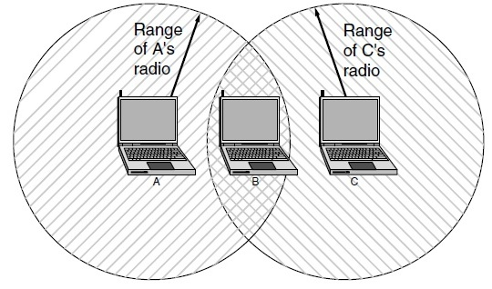
802.11 radios also have to deal with the problem of multiple transmissions that are sent at the same time will collide, which may interfere with reception. To handle this problem, 802.11 uses a CSMA (Carrier Sense Multiple Access).
To handle this problem, 802.11 uses a CSMA scheme and ALOHA.
The range of a single radio may not cover the entire system

Slide 63
Another problem is that of mobility. If a mobile client is moved away from the access point it is using and into the range of a different access point, some way of handing it off is needed.
The solution is that an 802.11 network can consist of multiple cells, each with its own access point, and a distribution system that connects the cells.
The distribution system is often switched Ethernet, but it can use any technology.
problem of security: Since wireless transmissions are broadcast, it is easy for nearby computers to receive packets of information that were not intended for them.
To prevent this, the 802.11 standard included an Encryption Scheme known as WEP (Wired Equivalent Privacy).
The idea was to make wireless security like that of wired security.
WEP has since been replaced with newer schemes that have different cryptographic details in the 802.11i standard, also called WPA- WiFi Protected Access, but now replaced by WPA2.

Slide 64
802.11 has caused a revolution in wireless networking that is set to continue.
Beyond buildings, it is starting to be installed in trains, planes, boats, and automobiles so that people can surf the Internet wherever they go. Mobile phones and all manner of consumer electronics, from game consoles to digital cameras, can communicate with it.

Slide 65
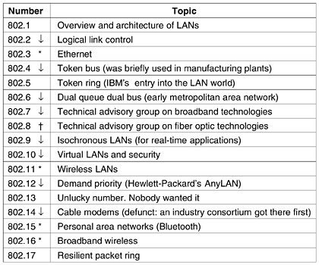
Network Standardization
The IEEE 802 series standards. The important ones are marked with *. The ones marked with ↓ are hibernating. The one marked with t gave up and disbanded itself.

Slide 66
PHYSICAL LAYER:
GUIDED TRANSMISSION MEDIA
Magnetic Media
Twisted Pairs
Coaxial Cable
Power Lines
Fiber Optics

Slide 67
Magnetic Media
One of the most common ways to transport data from one computer to another is to write them onto magnetic tape or removable media (e.g., recordable DVDs), physically transport the tape or disks to the destination machine, and read them back in again.
An industry-standard Ultrium tape can hold 800 gigabytes.
A box 60 × 60 × 60 cm can hold about 1000 of these tapes, for a total capacity of 800 terabytes, or 6400 terabits (6.4 petabits).
The cost of an Ultrium tape is around $40 when bought in bulk. A tape can be reused at least 10 times, so the tape cost is maybe $4000 per box per usage.
Never underestimate the bandwidth of a station wagon full of tapes hurtling down the highway.

Slide 68
Although the bandwidth characteristics of magnetic tape are excellent, the delay characteristics are poor.
Transmission time is measured in minutes or hours, not milliseconds.
For many applications an online connection is needed.
2. Twisted Pairs
One of the oldest and still most common transmission media is twisted pair.
A twisted pair consists of two insulated copper wires, typically about 1 mm thick.
The wires are twisted together in a helical form, just like a DNA molecule.
Twisting is done because two parallel wires constitute a fine antenna.
When the wires are twisted, the waves from different twists cancel out, so the wire radiates less effectively.

Slide 69
The most common application of the twisted pair is the telephone system.
Twisted pairs can run several kilometers without amplification, but for longer distances the signal becomes too attenuated and repeaters are needed.
Twisted pairs can be used for transmitting either analog or digital information.
The bandwidth depends on the thickness of the wire and the distance traveled, but several megabits/sec can be achieved for a few kilometers in many cases.
Due to their adequate performance and low cost, twisted pairs are widely used.
A category 5 twisted pair consists of two insulated wires gently twisted together. Four such pairs are typically grouped in a plastic sheath to protect the wires and keep them together.

Slide 70
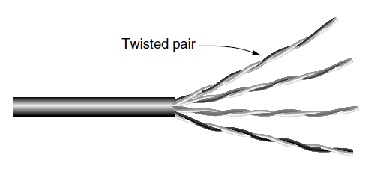
Category 5 UTP cable with four twisted pairs.
100-Mbps Ethernet uses two (out of the four) pairs, one pair for each direction.
To reach higher speeds, 1-Gbps Ethernet uses all four pairs in both directions (full- duplex links- used in both directions at the same time, like a two-lane road) simultaneously.
Half-duplex links - used in either direction, but only one way at a time, like a single-track railroad line.
A third category consists of links that allow traffic in only one direction, like a one-way street. They are called simplex links.

Slide 71
Category 3 cables that uses the same connector, but has more twists per meter. More twists result in less crosstalk and a better-quality signal over longer distances, making the cables more suitable for high-speed computer communication, especially 100-Mbps and 1-Gbps Ethernet LANs.
Category 6 or even Category 7- These categories has more stringent specifications to handle signals with greater bandwidths.
Some cables in Category 6 and above are rated for signals of 500 MHz and can support the 10-Gbps links that will soon be deployed.
Through Category 6, these wiring types are referred to as UTP (Unshielded Twisted Pair) as they consist simply of wires and insulators.
In contrast to these, Category 7 cables have shielding on the individual twisted pairs, as well as around the entire cable (but inside the plastic protective sheath). Shielding reduces the susceptibility to external interference and crosstalk with other nearby cables to meet demanding performance specifications.
Expensive shielded twisted pair cables that IBM introduced in the early 1980s, but which did not prove popular outside of IBM installations.

Slide 72
3. Coaxial Cable
It has better shielding and greater bandwidth than unshielded twisted pairs, so it can span longer distances at higher speeds.
Two kinds of coaxial cable are widely used.
One kind, 50-ohm cable, is commonly used when it is intended for digital transmission from the start.
The other kind, 75-ohm cable, is commonly used for analog transmission and cable television.
Starting in the mid- 1990s, cable TV operators began to provide Internet access over cable, which has made 75-ohm cable more important for data communication.
A coaxial cable consists of a stiff copper wire as the core, surrounded by an insulating material. The insulator is encased by a cylindrical conductor, often as a closely woven braided mesh.
The outer conductor is covered in a protective plastic sheath(cover).

Slide 73
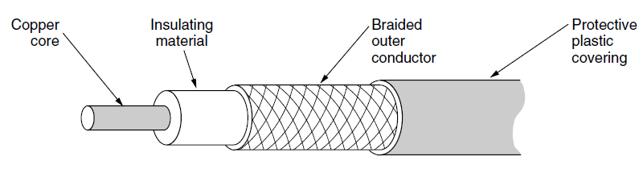
A cutaway view of a coaxial cable
The construction and shielding of the coaxial cable give it a good combination of high bandwidth and excellent noise immunity.
The bandwidth possible depends on the cable quality and length. Modern cables have a bandwidth of up to a few GHz.
Coaxial cables used to be widely used within the telephone system for long-distance lines but have now largely been replaced by fiber optics on long haul routes.
Coax is still widely used for cable television and metropolitan area networks.

Slide 74
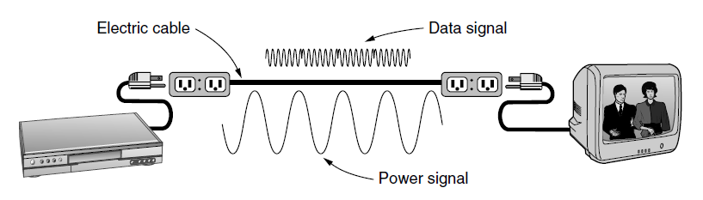
4. Power Lines
A network that uses household electrical wiring

Slide 75
5. Fiber Optics
An optical transmission system has three key components:
The Light Source: A pulse of light indicates a 1 bit and the absence of light indicates a 0 bit.
The Transmission Medium is an ultra-thin fiber of glass
The detector generates an electrical pulse when light falls on it
By attaching a light source to one end of an optical fiber and a detector to the other, we have a unidirectional data transmission system that accepts an electrical signal, converts and transmits it by light pulses, and then reconverts the output to an electrical signal at the receiving end.
This transmission system would leak light and be useless in practice.

Slide 76
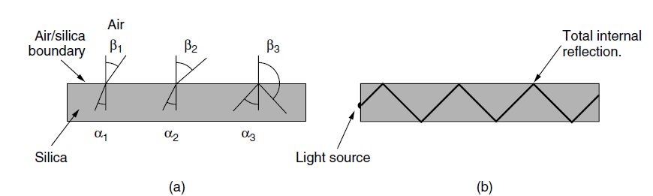
(a) Three examples of a light ray from inside a silica fiber impinging
on the air/silica boundary at different angles.
(b) Light trapped by total internal reflection and can propagate for
many kilometers with virtually no loss.
Single-mode fibers can transmit data at 100 Gbps for 100 km without amplification.
Even higher data rates have been achieved in the laboratory for shorter distances.

Slide 77
Transmission of Light Through Fiber
Optical fibers are made of glass, which, in turn, is made from sand, an inexpensive raw material available in unlimited amounts.
Glassmaking was known to the ancient Egyptians, but their glass had to be no more than 1 mm thick or the light could not shine through.
Glass transparent enough to be useful for windows was developed during the Renaissance (regeneration).
The glass used for modern optical fibers is so transparent that if the oceans were full of it instead of water, the seabed would be as visible from the surface as the ground is from an airplane on a clear day.

Slide 78
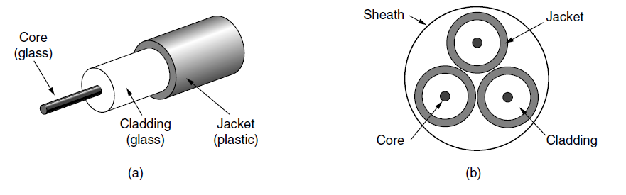
Fiber Cables
Fiber optic cables are similar to coax, except without the braid.
At the center is the glass core through which the light propagates. In multimode fibers, the core is typically 50 microns in diameter, about the thickness of a human hair.
In single-mode fibers, the core is 8 to 10 microns.
Side view of a single fiber.
(b) End view of a sheath with three fibers

Slide 79
Fibers can be connected in three different ways.
First, they can terminate in connectors and be plugged into fiber sockets.
Connectors lose about 10 to 20% of the light, but they make it easy to reconfigure systems.
Second, they can be spliced mechanically.
Mechanical splices just lay the two carefully cut ends next to each other in a special sleeve and clamp them in place. Alignment can be improved by passing light through the junction and then making small adjustments to maximize the signal. Mechanical splices take trained personnel about 5 minutes and result in a 10% light loss.
Third, two pieces of fiber can be fused (melted) to form a solid connection. A fusion splice is almost as good as a single drawn fiber, but even here, a small amount of attenuation occurs.

Slide 80
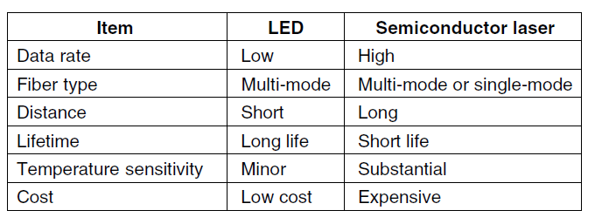
Two kinds of light sources are typically used to do the signaling. These are LEDs (Light Emitting Diodes) and semiconductor lasers.
A comparison of semiconductor diodes and LEDs as light sources.

Slide 81
Comparison of Fiber Optics and Copper Wire
Fiber can handle much higher bandwidths than copper.
Due to the low attenuation, repeaters are needed only about every 50 km on long lines, versus about every 5 km for copper, resulting in a big cost saving.
Fiber also has the advantage of not being affected by power surges, electromagnetic interference, or power failures.
Nor is it affected by corrosive chemicals in the air, important for harsh factory environments.
Fiber has less weight compare to copper.

Slide 82
WIRELESS TRANSMISSION
The Electromagnetic Spectrum
Radio Transmission
Microwave Transmission
Infrared Transmission
Light Transmission
People who need to be online for all time. For these mobile users Twisted Pairs, Coaxial Cable and Fiber Optics are of no use.
For mobile users , Wireless communication is the solution.

Slide 83
The Electromagnetic Spectrum
The number of oscillations per second of a wave is called its frequency, f, and is measured in Hz (in honor of Heinrich Hertz).
The distance between two consecutive maxima (or minima) is called the wavelength, which is universally designated by the Greek letter λ (lambda).
First form of spread spectrum, frequency hopping spread spectrum, the transmitter hops from frequency to frequency hundreds of times per second. It is popular for military communication because it makes transmissions hard to detect and next to impossible to jam. It also offers good resistance to multipath fading and narrowband interference because the receiver will not be stuck on an impaired frequency for long enough to shut down communication.

Slide 84
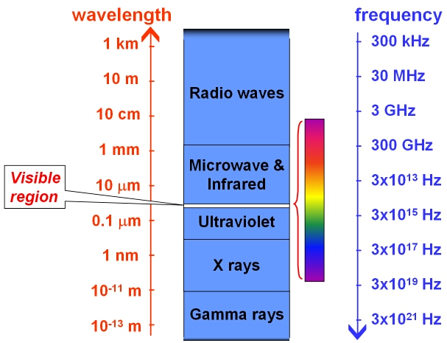
Electromagnetic Spectrum

Slide 85
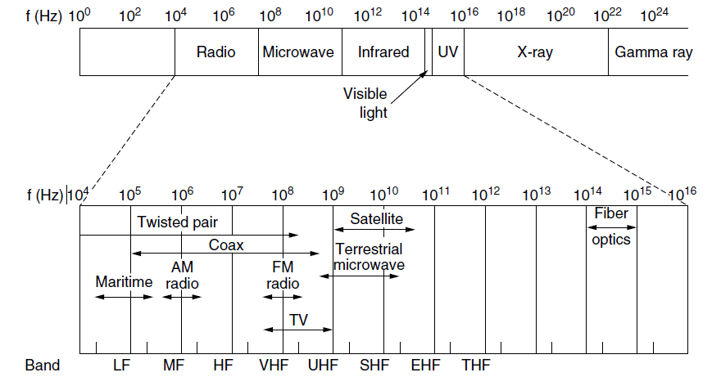
The electromagnetic spectrum and its uses for communication.
Very high frequency | VHF
Ultra high frequency | UHF
Super high frequency | SHF
Extremely high frequency | EHF
Terahertz or Tremendously high frequency | THz or THF

Slide 86
A second form of spread spectrum, direct sequence spread spectrum, uses a code sequence to spread the data signal over a wider frequency band.
It is widely used commercially as a spectrally efficient way to let multiple signals share the same frequency band.
These signals can be given different codes, a method called CDMA (Code Division Multiple Access).
A third method of communication with a wider band is UWB (Ultra- Wide Band) communication. UWB sends a series of rapid pulses, varying their positions to communicate information.
The rapid transitions lead to a signal that is spread thinly over a very wide frequency band.
UWB has very little energy at any given frequency when used for short-range transmission, it does not cause harmful interference to those other narrowband radio signals. It is said to underlay the other signals.

Slide 87
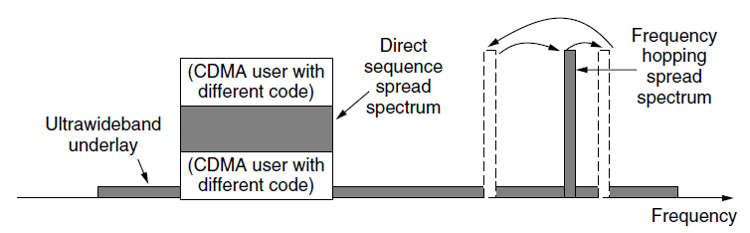
Spread spectrum and ultra-wideband (UWB) communication.

Slide 88
Radio Transmission
Radio frequency (RF) waves are easy to generate, can travel long distances, and can penetrate buildings easily, so they are widely used for communication, both indoors and outdoors.
Radio waves also are omnidirectional, meaning that they travel in all directions from the source, so the transmitter and receiver do not have to be carefully aligned physically.
The signal energy is spread more thinly over a larger surface. This attenuation is called path loss.
At high frequencies, radio waves tend to travel in straight lines and bounce off obstacles.
Path loss still reduces power, though the received signal can depend strongly on reflections as well.
High-frequency radio waves are also absorbed by rain and other obstacles to a larger extent than are low-frequency ones.

Slide 89
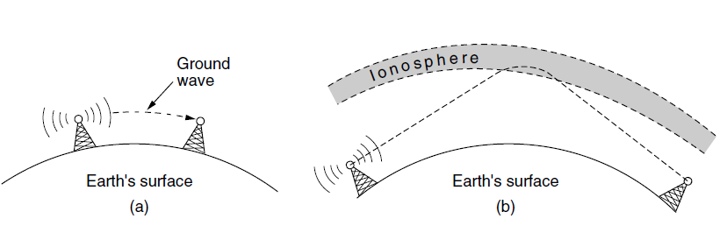
(a) In the VLF, LF, and MF bands, radio waves follow the curvature of the earth.
(b) In the HF band, they bounce off the ionosphere.
The military also communicate in the HF and VHF bands.

Slide 90
Microwave Transmission
Microwaves travel in a straight line, so if the towers are too far apart, the earth will get in the way. Thus, repeaters are needed periodically.
The distance between repeaters goes up very roughly with the square root of the tower height.
For 100-meter-high towers, repeaters can be 80 km apart.
Unlike radio waves at lower frequencies, microwaves do not pass through buildings well.
Multipath fading is a serious problem.
Microwave communication is so widely used for long-distance telephone communication, mobile phones, television distribution, and other purposes that a severe shortage of spectrum has developed.
Microwave is also relatively inexpensive.

Slide 91
Putting up two simple towers (which can be just big poles with four guy wires) and putting antennas on each one may be cheaper than burying 50 km of fiber through a congested urban area or up over a mountain, and it may also be cheaper than leasing the telephone company’s fiber, especially if the telephone company has not yet even fully paid for the copper it ripped out when it put in the fiber.

Slide 92
Infrared Transmission
Widely used for short-range communication.
The remote controls used for televisions, VCRs, and stereos all use infrared communication.
They are relatively directional, cheap, and easy to build.
A major drawback is they do not pass through solid objects.
Infrared communication has a limited use on the desktop, for example, to connect notebook computers and printers with the IrDA (Infrared Data Association) standard, but it is not a major player in the communication game.

Slide 93
Light Transmission
A more modern application is to connect the LANs in two buildings via lasers mounted on their rooftops.
This scheme offers very high bandwidth at very low cost and is relatively secure because it is difficult to tap a narrow laser beam. It is also relatively easy to install and, unlike microwave transmission, does not require an FCC license.

Slide 94
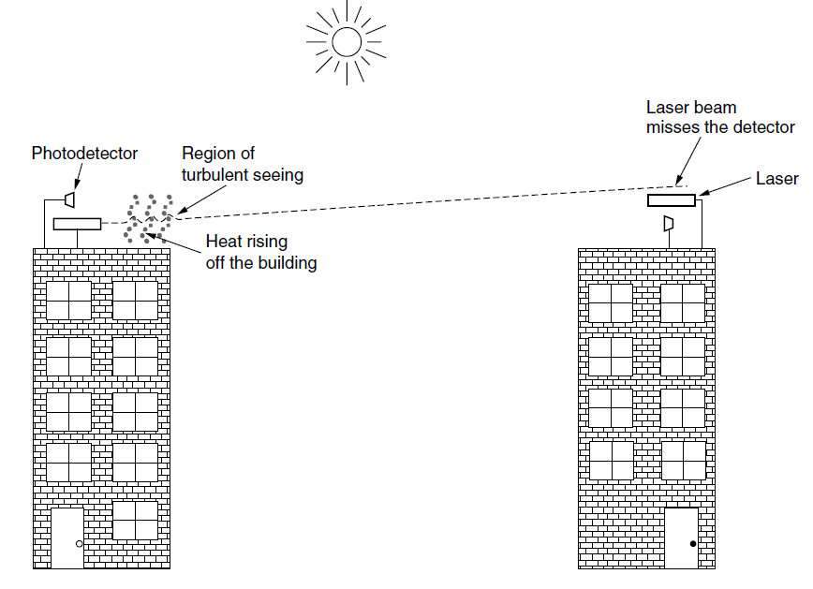
Convection currents can interfere with laser communication systems.
A bidirectional system with two lasers is pictured here.

